Slide 1
JOB MARKET ANALYSIS (PRDA – 04)
Introduction
This project analyzes Data Science job postings collected from the database provided. The objective is to identify job market trends, salary distributions, hiring industries, top recruiting companies, and the skills required for Data Science-related roles. The analysis helps understand the current demand and opportunities available in the Data Science industry.
Submitted By:
Name: Bandaru Harika Hasini
Roll No: CA11202516329
Course: CDA

Slide 2
PROJECT OBJECTIVE
Objective
The objective of this project is to perform a comprehensive analysis of Data Science job postings and identify key trends within the job market. The analysis helps understand which locations offer the highest opportunities, which industries recruit the most Data Science professionals, the salary ranges offered by employers, and the skills required for different job roles.
Tools Used
MySQL Database
SQL Queries
Power BI
Data Analysis Techniques
Data Visualization

Slide 3
DATASET OVERVIEW
Dataset Description
The dataset contains information related to Data Science job postings collected from multiple organizations. The data includes job titles, company names, salary estimates, industry information, location details, educational requirements, ratings, and job descriptions.
Data Preparation
The dataset was cleaned and transformed before analysis. Missing values were handled, salary information was standardized, and relevant fields were extracted for visualization and reporting purposes.

Slide 4
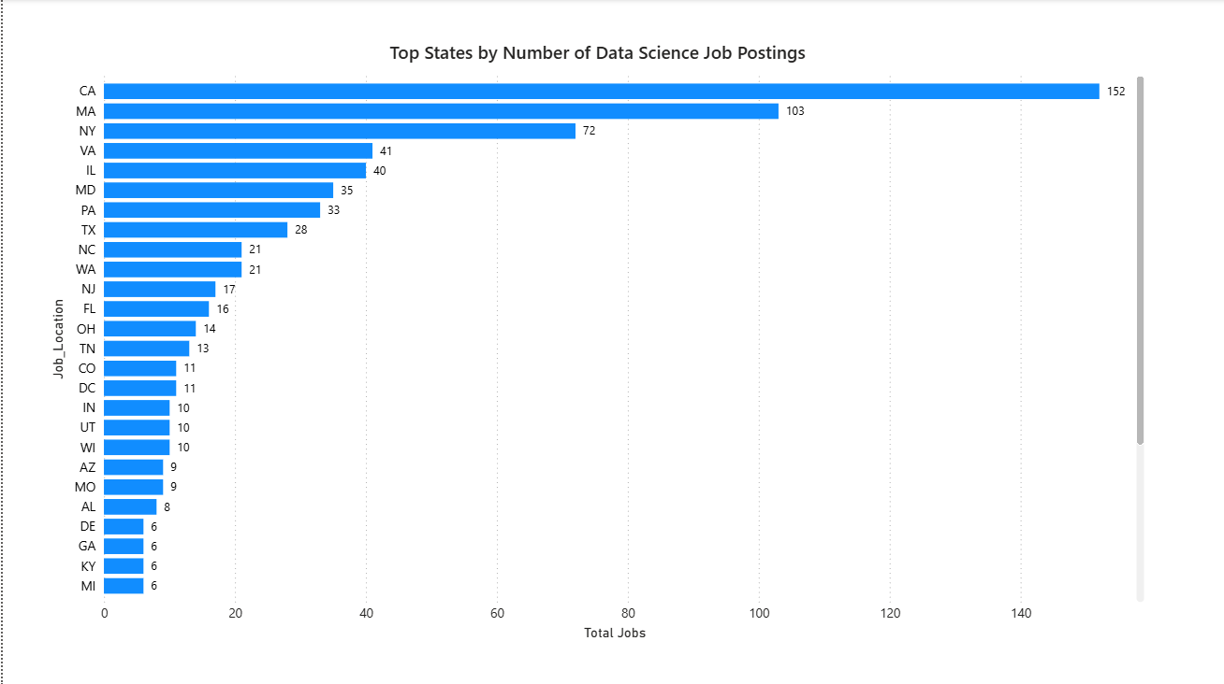
STATES WITH MOST NUMBER OF JOBS
Analysis California leads with 152 job postings, followed by Massachusetts (103) and New York (72). These states have the highest demand for Data Science professionals.
Insight Most Data Science jobs are concentrated in a few key states, providing better career opportunities for job seekers in these regions.

Slide 5
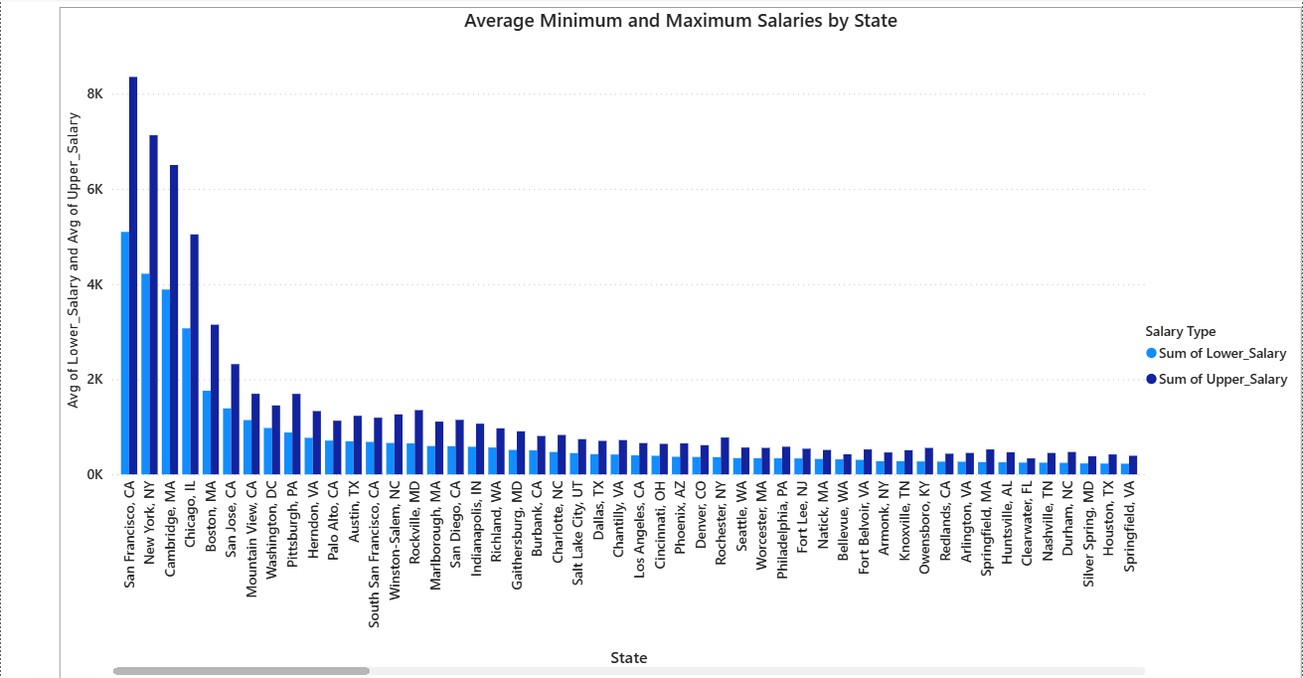
AVERAGE MINIMUM AND MAXIMUM SALARIES BY STATE
Analysis
This chart compares the average minimum and maximum salary ranges offered in different states. Significant variations can be observed between locations, reflecting differences in demand, cost of living, and industry presence.
Insight
Higher-paying states attract skilled Data Science professionals. Salary levels are often influenced by industry demand and market competition. Candidates can benefit by targeting these regions.

Slide 6
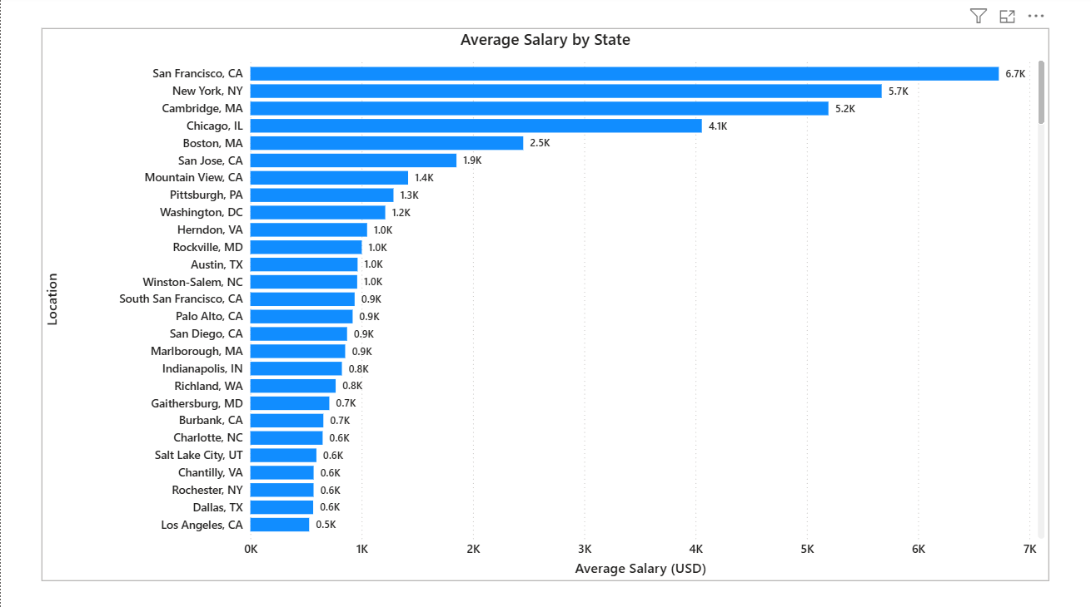
AVERAGE SALARY BY STATE
Analysis
The average salary analysis highlights how compensation differs among various states. Locations such as San Francisco and New York offer higher average salaries due to the concentration of data-driven businesses and increased demand for specialized talent.
Insight
Organizations in highly competitive markets are willing to provide better compensation to secure qualified professionals.

Slide 7
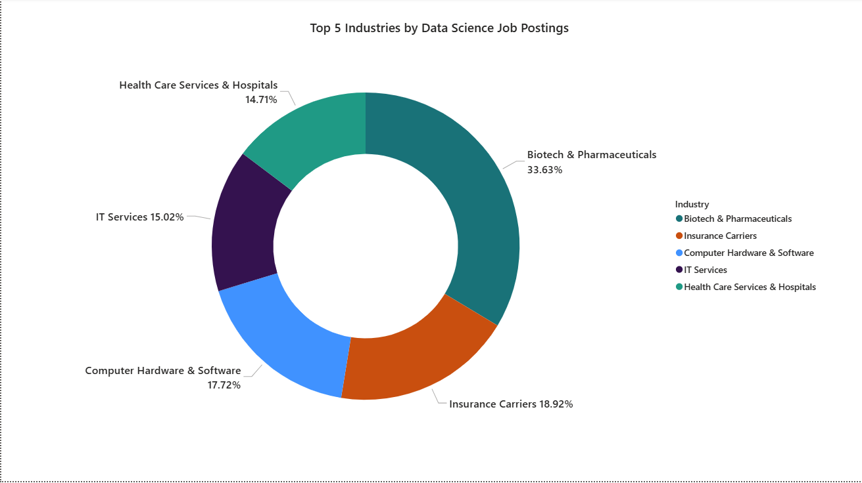
TOP 5 INDUSTRIES WITH DATA SCIENCE JOB POSTINGS
Analysis
The chart illustrates the top industries actively recruiting Data Science professionals. Biotech and Pharmaceuticals lead the hiring market, followed by Insurance, Computer Hardware and Software, IT Services, and Healthcare organizations.
Insight
The findings demonstrate that Data Science has become an essential business function across multiple industries rather than being limited to technology companies.

Slide 8
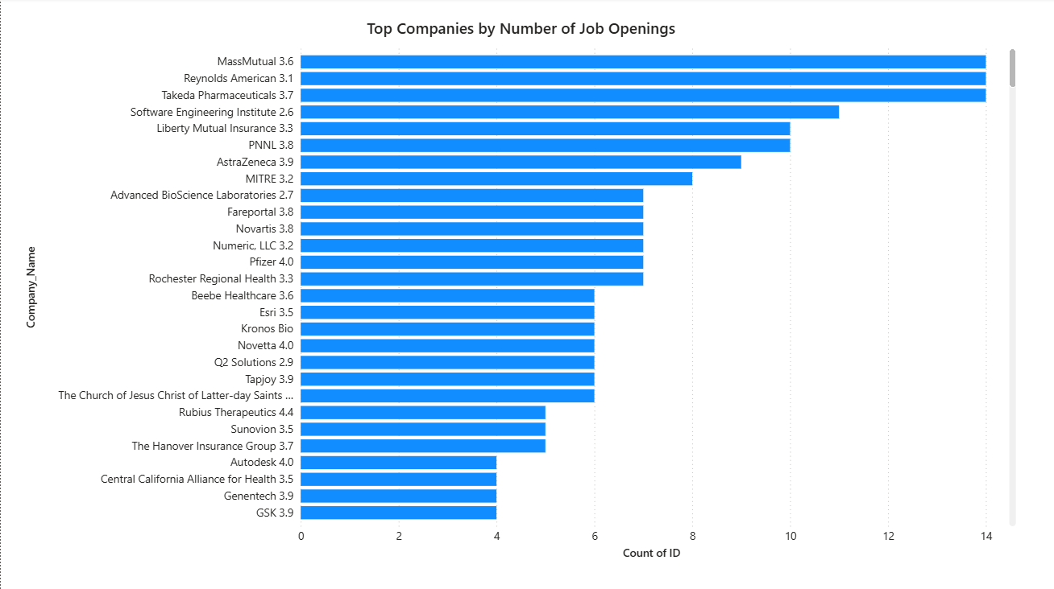
COMPANIES WITH MAXIMUM JOB OPENINGS
Analysis
Several organizations have a significantly higher number of Data Science job openings compared to others. These companies actively invest in analytics, business intelligence, machine learning, and artificial intelligence initiatives.
Insight
Companies with larger hiring volumes indicate strong organizational commitment toward data-driven innovation and strategic decision-making.

Slide 9
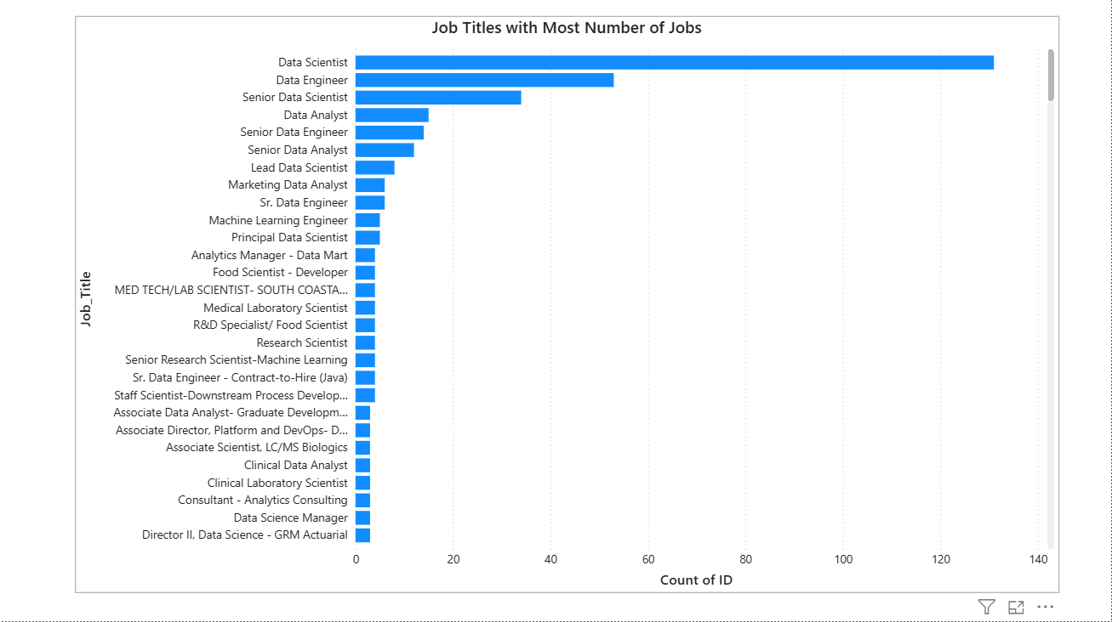
JOB TITLES WITH MOST NUMBER OF JOBS
Analysis
This visualization identifies the most frequently advertised Data Science-related job positions. Data Scientist emerges as the most demanded role, followed by Data Engineer, Senior Data Scientist, and Data Analyst positions.
Insight
Organizations require professionals capable of collecting, managing, analyzing, and interpreting large volumes of data to support business operations.

Slide 10
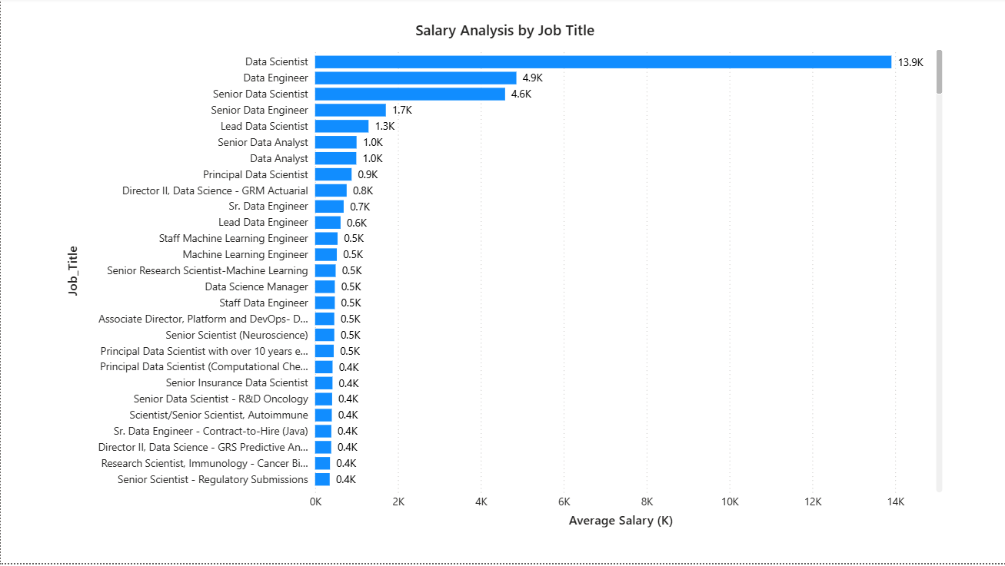
JOB TITLE SALARY ANALYSIS
Analysis
This chart compares salary levels across various Data Science job roles. Senior-level positions generally receive higher compensation due to increased responsibilities, specialized expertise, and leadership requirements.
Insight
Professionals with advanced technical knowledge, machine learning expertise, and industry experience command higher salaries in the job market.

Slide 11
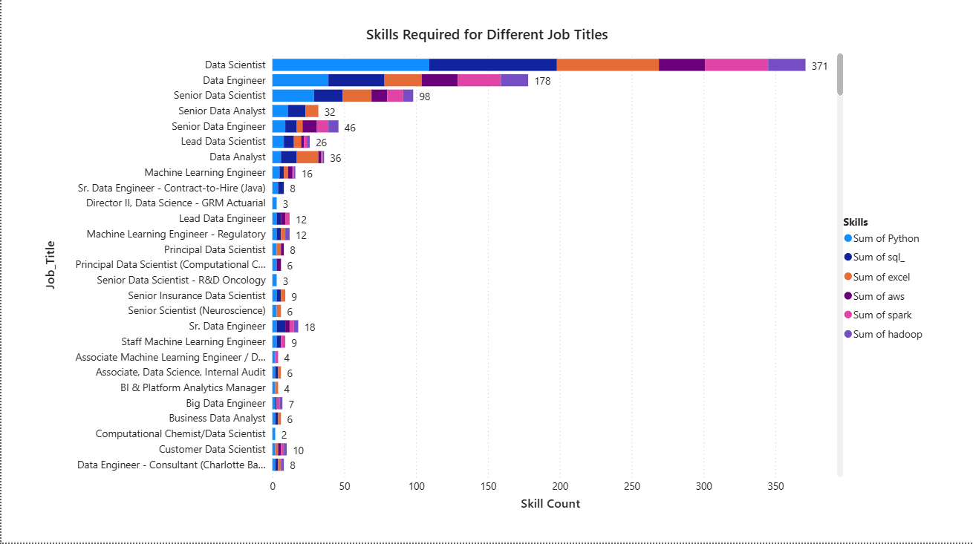
SKILLS REQUIRED BY COMPANIES
Analysis
The skills analysis identifies the technologies and competencies most frequently requested by employers. Python, SQL, Machine Learning, Data Visualization, Tableau, Power BI, Statistics, and Excel are among the most demanded skills.
Insight
Modern organizations expect candidates to possess both technical and analytical capabilities that support data-driven decision-making.

Slide 12
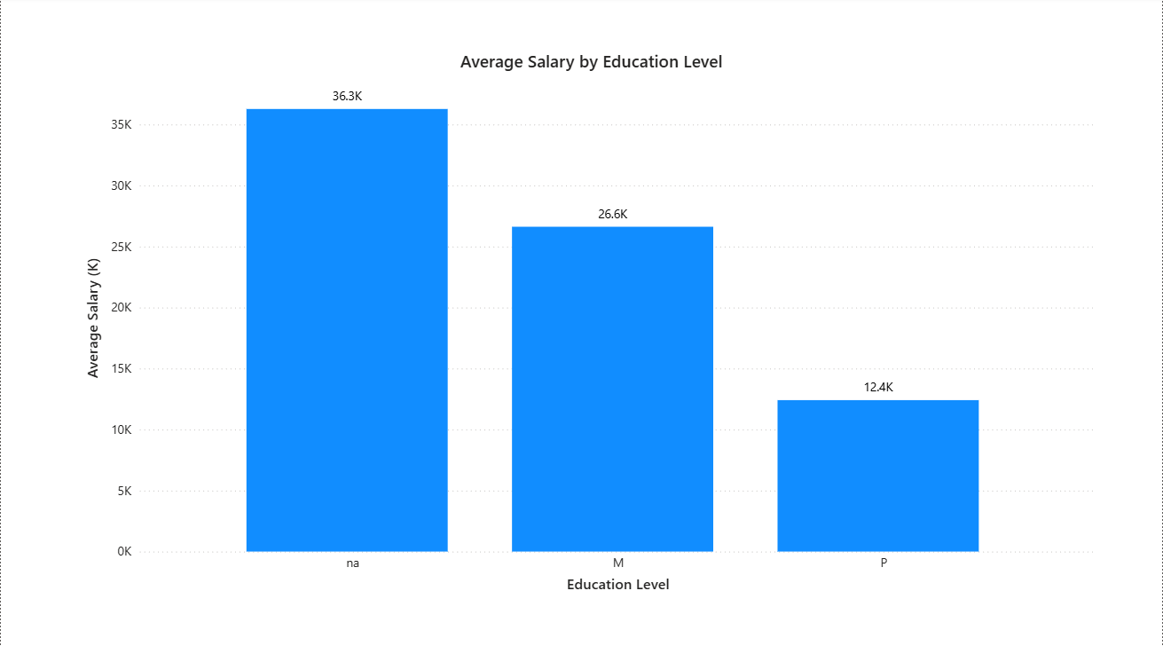
RELATION BETWEEN SALARY AND EDUCATION
Analysis
This visualization explores the relationship between educational qualifications and average salary levels. Higher educational qualifications generally correspond with higher salary packages.
Insight
Employers recognize the value of advanced education and specialized knowledge when recruiting Data Science professionals.

Slide 13
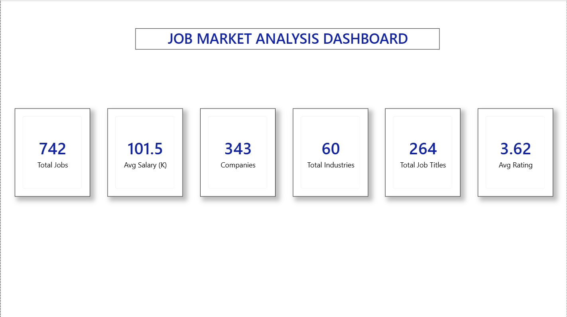
OVERALL JOB MARKET ANALYSIS
Analysis
The KPI dashboard provides a high-level summary of the Data Science job market. It highlights the total number of jobs, average salary, participating companies, industries, job titles, and overall company ratings.
Insights
The results indicate strong hiring activity, competitive salaries, and growing demand for Data Science professionals across various industries.

Slide 14
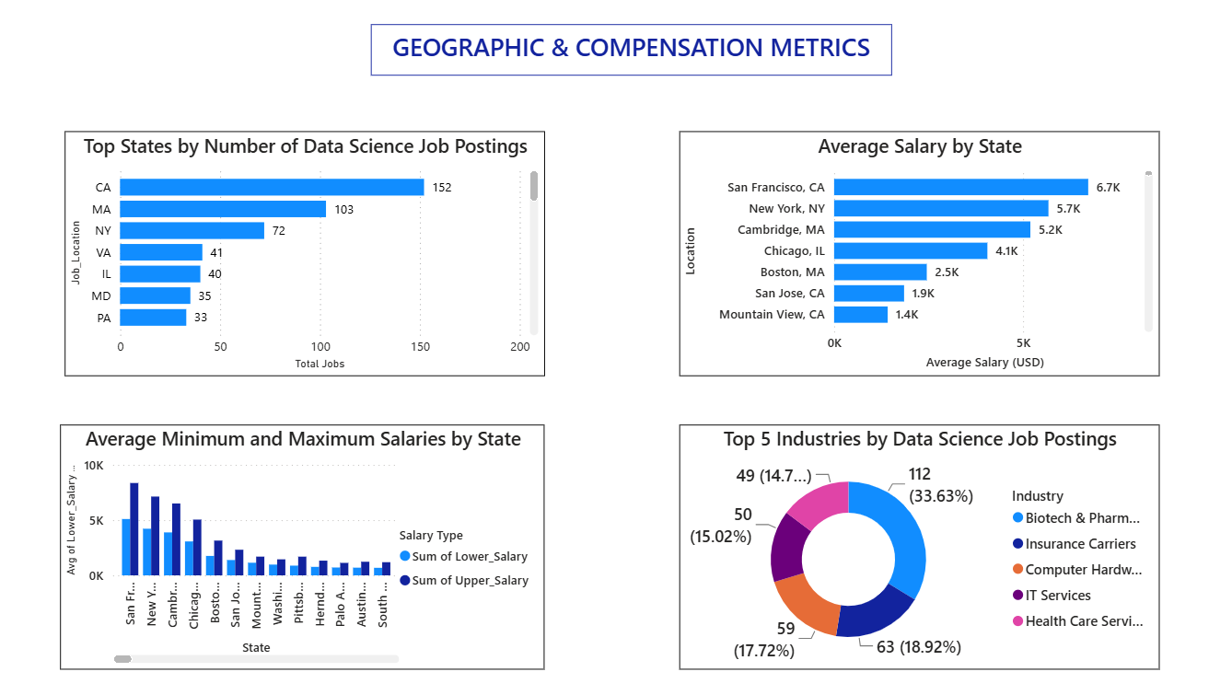
OVERALL INSIGHTS & RECOMMENDATIONS

Slide 15
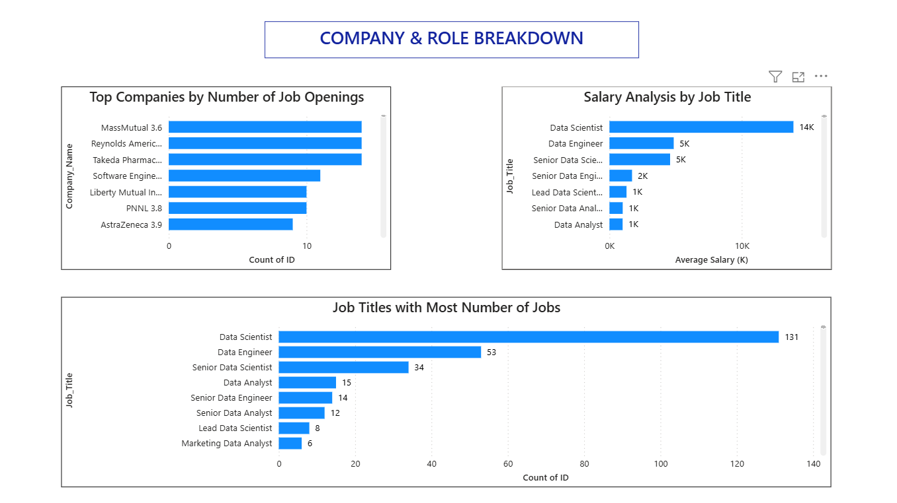
INDUSTRY AND COMPANY ANALYSIS

Slide 16
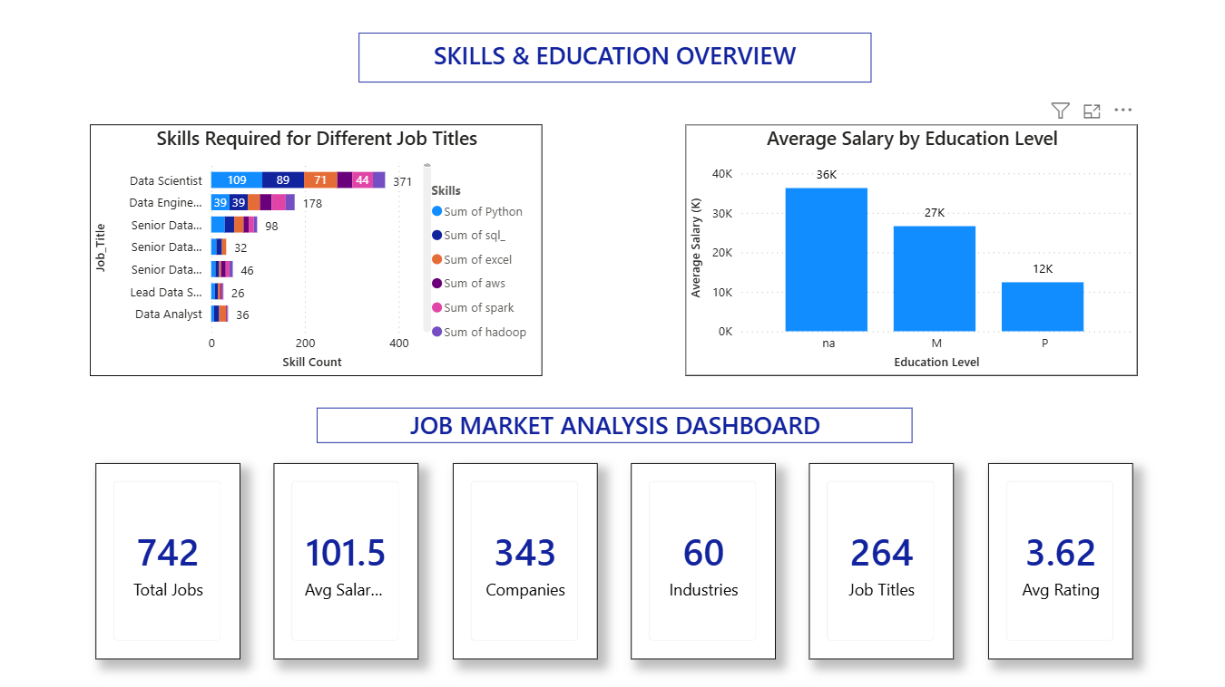
SKILLS AND SALARY ANALYSIS

Slide 17
DASHBOARD INSIGHTS & COMPANY RECOMMENDATIONS
Analysis
The Power BI dashboards provide a comprehensive view of the Data Science job market, covering job opportunities, salary trends, industry demand, company hiring patterns, required skills, and education levels. The visualizations help identify key market trends and support data-driven decision-making.
Key Insights
California leads in job opportunities, while San Francisco offers the highest salaries. Biotech & Pharmaceuticals dominate hiring, and Data Scientist is the most demanded role.
Recommendations
Companies should offer competitive salaries and invest in employee training. Hiring skilled data professionals and promoting data-driven decisions can improve business performance.

Slide 18
CONCLUSION
This project analyzed the Data Science job market using SQL and Power BI to identify important trends and patterns. The findings show that California leads in job opportunities, while San Francisco offers the highest salaries. Biotech & Pharmaceutical industries are among the top recruiters of Data Science professionals. Data Scientist emerged as the most demanded job role, with Python and SQL being the most sought-after skills. The analysis also indicates that higher education can contribute to better salary opportunities. Overall, the project highlights the growing demand for Data Science professionals across various industries.

Slide 19
THANK YOU

